Slide 1


THE INSTITUTE FOR CONSERVATION ADVOCACY RESEARCH AND EDUCATION
A Napa 501c3 since 2004
PRESENTS
THE NAPA RIVER, THE LOST RIVER
Our mission:
To protect, conserve and restore aquatic eco-systems,
Both surface water and groundwater, from
San Francisco Bay to the Oregon Boarder,
Including rigorous scientific monitoring of the health
of the Napa River
Since 2000

Slide 2


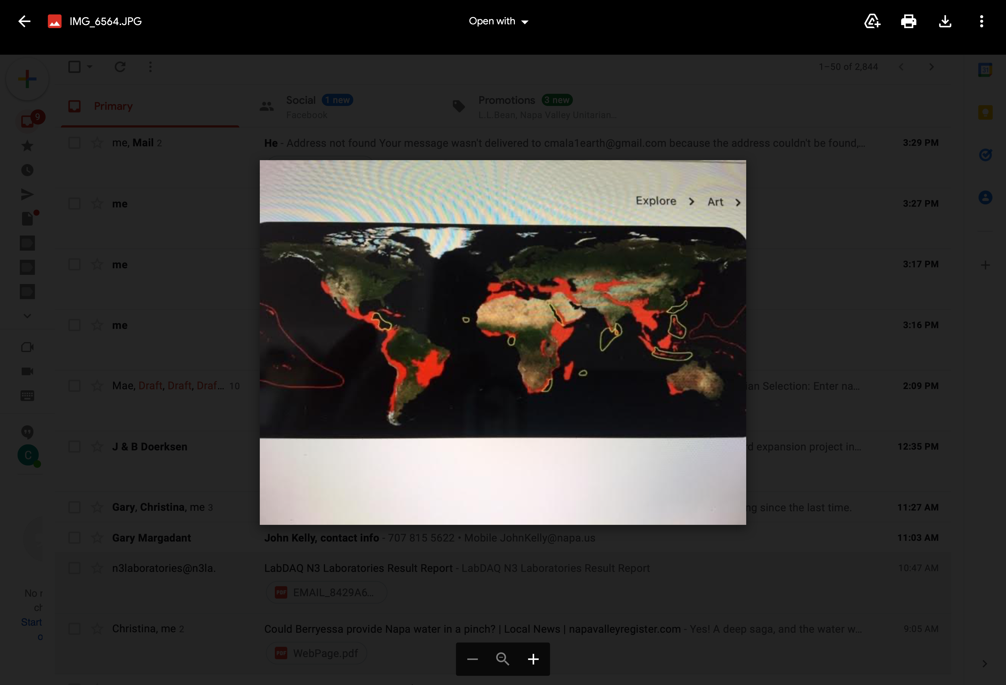

<style nonce="oNNTiqvcZaFZStAmiGkoCw"> #loading {display:none} </style><form id="null" action="?ui=html&amp;zy=c" method="post"><input type="hidden" name="at" value="null"><font face=arial>JavaScript must be enabled in order for you to use Gmail in standard view. However, it seems JavaScript is either disabled or not supported by your browser. To use standard view, enable JavaScript by changing your browser options, then <a href="">try again</a>.<p>To use Gmail's basic HTML view, which does not require JavaScript, <input type="submit" value="click here" class="submit_as_link">.</p></font></form><form id="null" action="?ui=mobile&amp;zyp=c" method="post"><input type="hidden" name="at" value="null"><p><font face=arial>If you want to view Gmail on a mobile phone or similar device <input type="submit" value="click here" class="submit_as_link">.</font></p></form>
Skip to content
Using Gmail with screen readers
Search
Chris
No recent chats Start a new one
Napa is a biological hot spot on the planet!
Think Globally and Act Locally!
As evidenced by:
With 34 native species of fish the Napa River has the most biodiversity of any River west of the Sierras.
Napa has is a Mediterranean climate that supports three major vegetation types: coastal temperate rain
forest to the west,
chaparrals and oak woodlands.
When studying the Napa River aquatic eco-system ICARE discovered new species of aquatic insects like:
caddis-fly, blind crustacean, spring snail and a rare stone fly plus
In 2021 we collected a new specie of algae.

Slide 3

Three Important Actions to Stop Climate Change
1. Convert to Renewable energy i.e., wind, solar
2. Protect Natural Carbon Sequestration: forests, wetlands
The Intergovernmental Panel on Climate Change
Report
(No fossil fuel products)
3. Reduce, Reuse, Repurpose, Recycle
Global climate change has risen 1.1 degrees
celcius and rising.
Catastrophic climate change occurs at and before
1.5 degrees celsius.
Everyone must use their voice and actions to prevent the 1.5 degree rise in global temperature
Together one for all we can do this!
BELIEVE IN THE CHANGE THAT IS YOU!

Slide 4
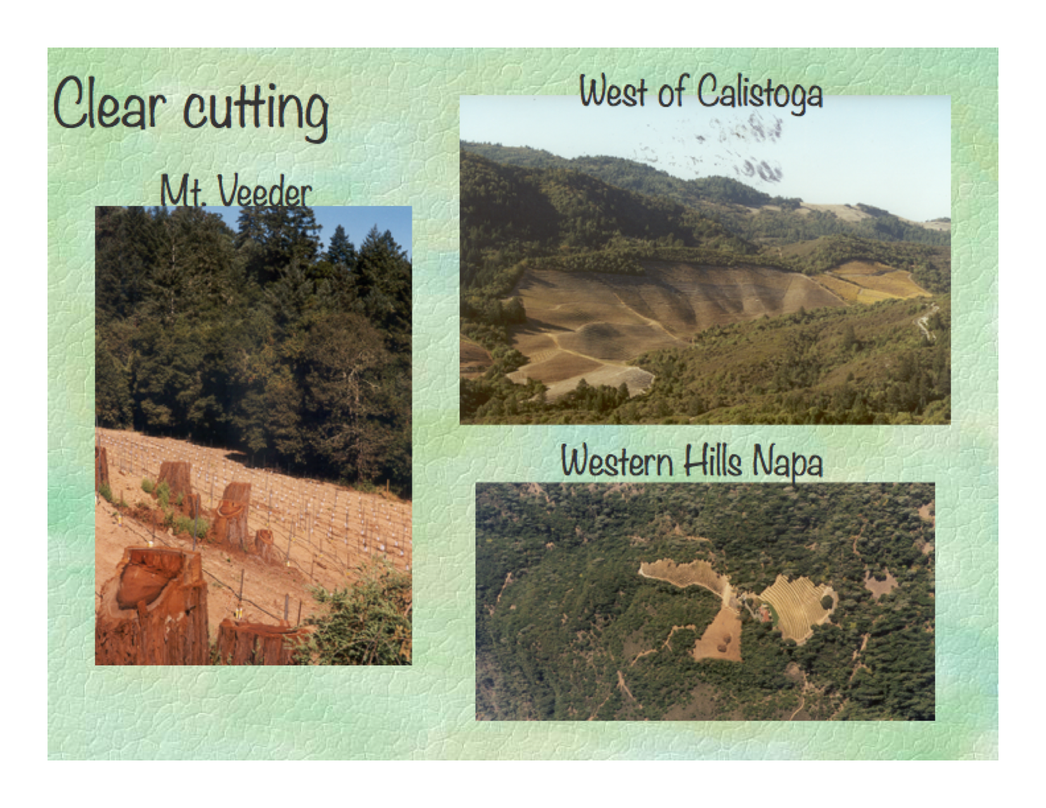
THE MOST HARMFUL LAND USE IN
NAPA
IS FOREST CONVERSION TO VINEYARDS

Slide 5
Kortum Canyon Deforestation
HARMS GROUNDWATER RECHARGE BECAUSE THE
WATER FLOWS QUICKLY OFF THESE HILLSIDE VINEYARD TO THE
NAPA RIVER WHERE IT ERODES THE BED AND BANKS
CAUSING INCISION/DOWN CUTTING OF THE
RIVER

Slide 6
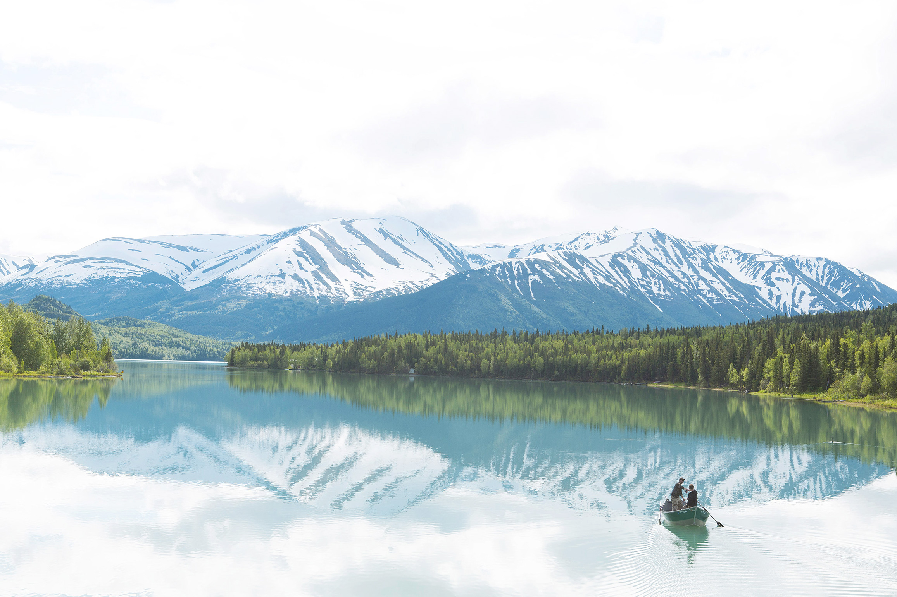
ICARE’s Board Members Kayaking the Napa River
Hundreds of ancient trees are falling into the River from erosion seen here.

Slide 7
Land Owners Trash the River

Slide 8
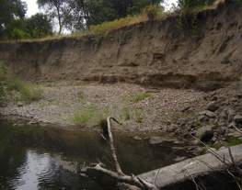
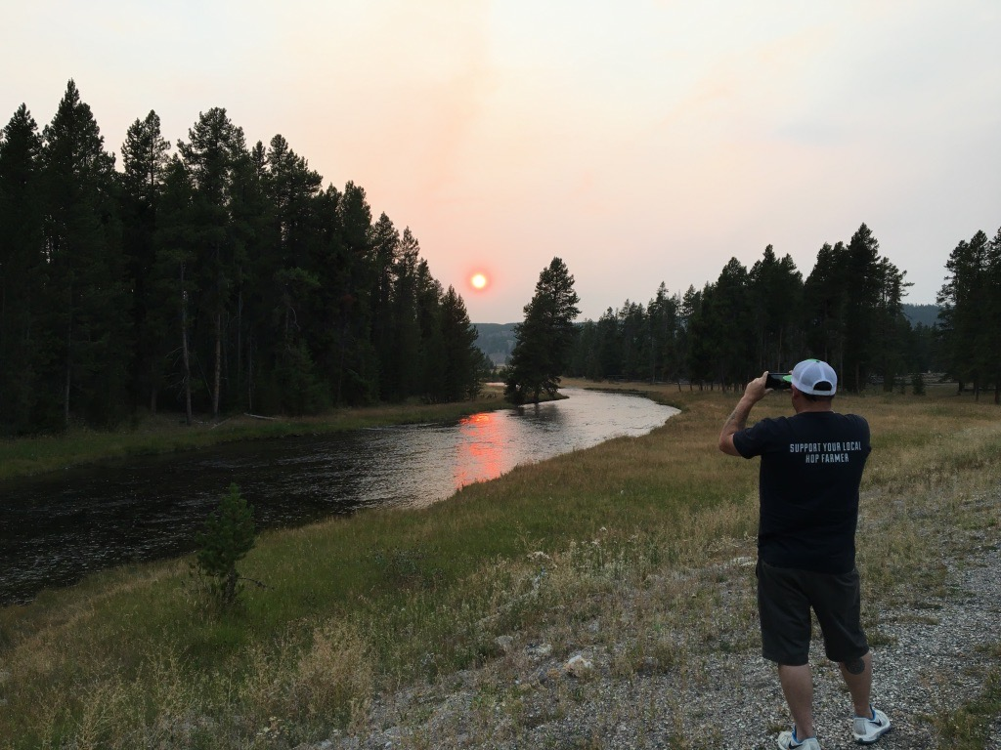
Napa River deeply incised and not connected to the floodplain
40 foot bank erosion from urbanization/
deforestation
Banks Too Steep for the Public to Safely Access the Napa River, a Lost River.
Yellowstone River

Slide 9
Illegal Water Diversions

Slide 10
Dangerous Algal Blooms

Slide 11
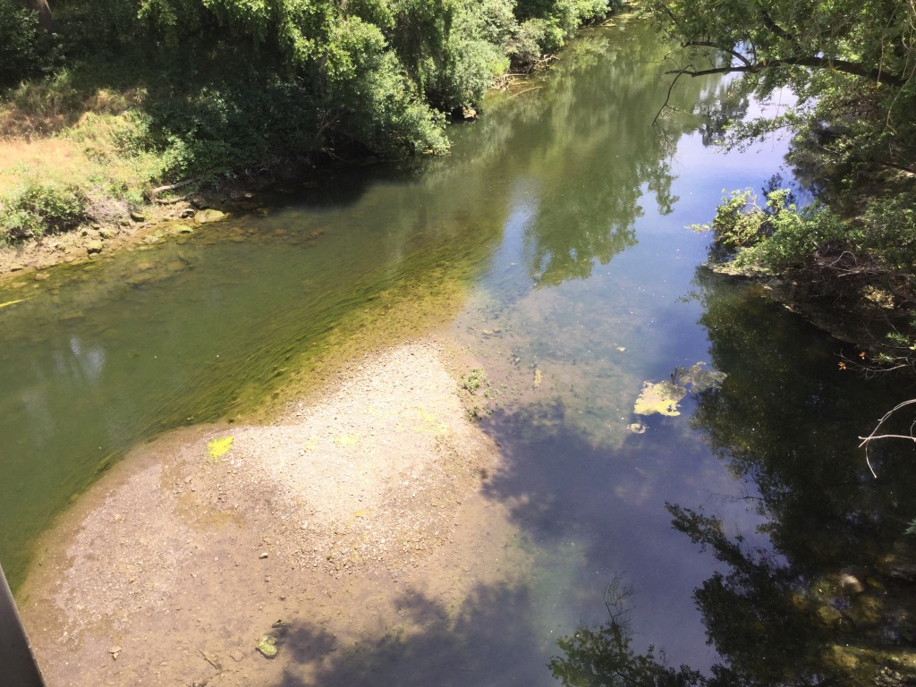
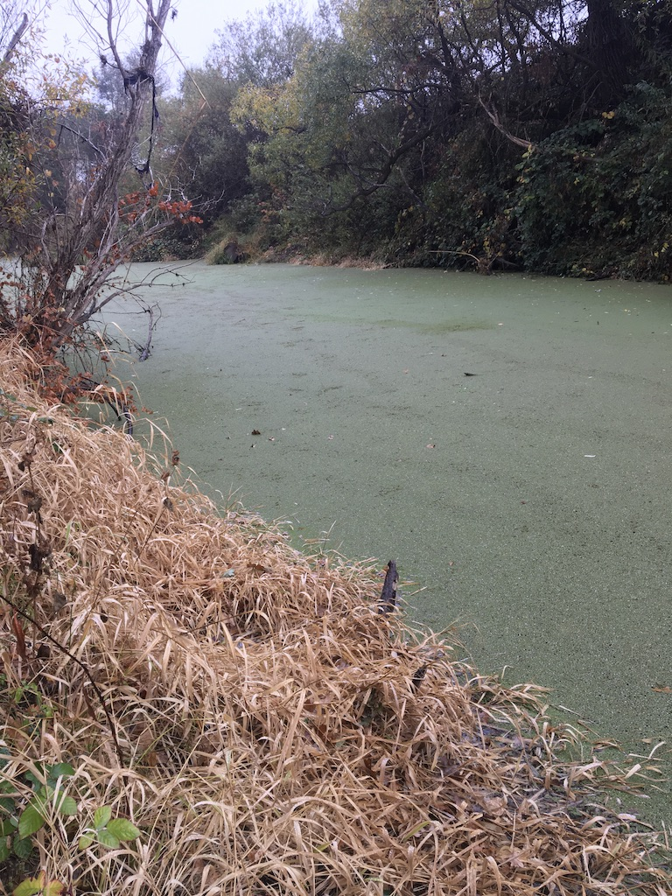
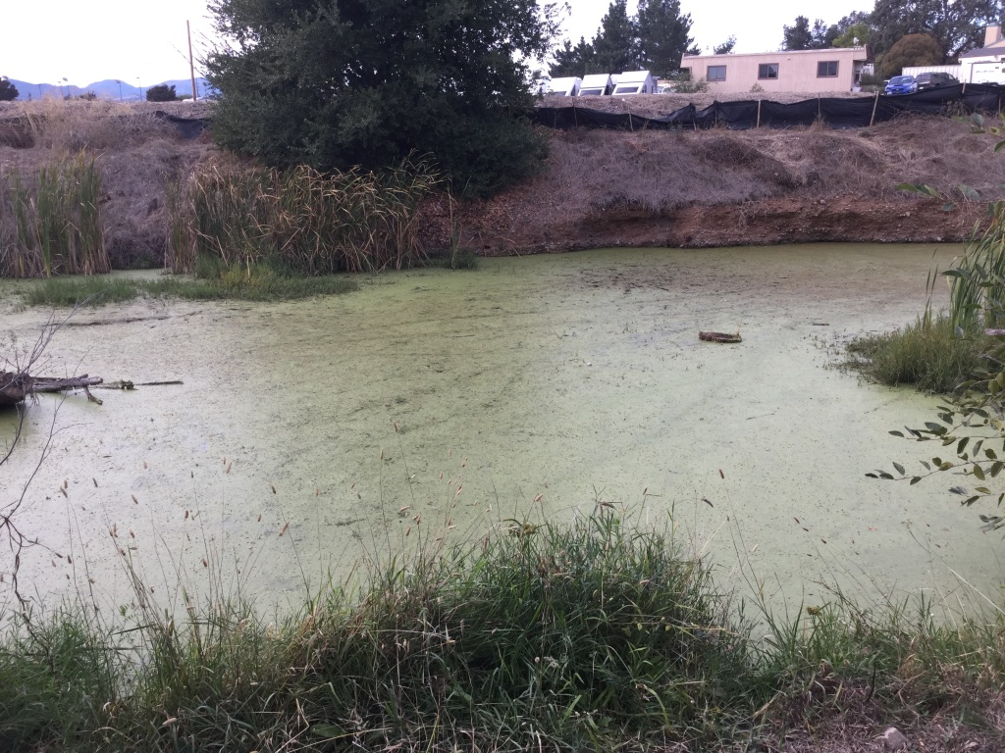
RUN OFF FROM
VINEYARDS
POLLUTES
THE RIVER WITH
SEDIMENT AND
NUTRIENTS
CAUSING SEVERE
ALGAE BLOOMS
SEDIMENT FILLS THE RIVER DESTROYING SALMON AND STEELHEAD HABITAT
ALGAE CAN TURN
TOXIC
PLANTS AND ALGAE COVERS THE
RIVER
ALGAE AND PLANTS COVER TULOCAY CREEK

Slide 12
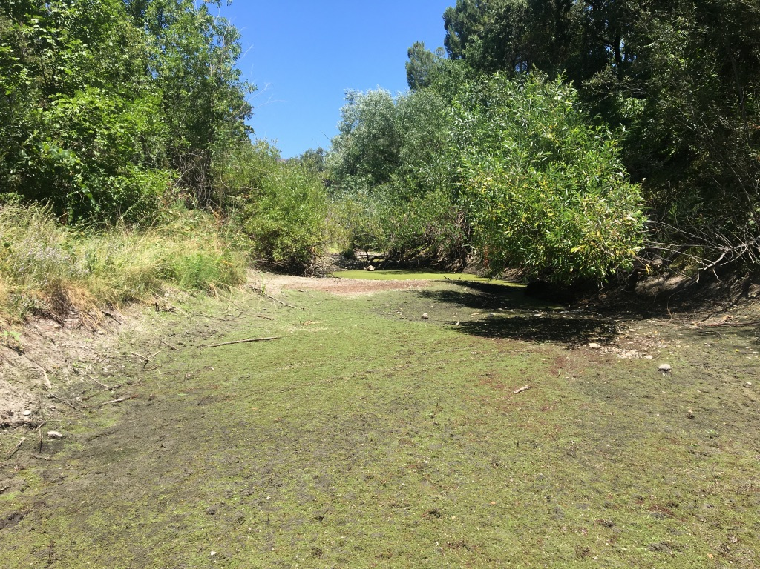
WATER DIVERSIONS INCLUDING
GROUNDWATER PUMPING IS DEWATERING
THE NAPA RIVER
The Napa River water diversions have been over appropriated
Napa River at Pope Street Bridge dry by July 15th 2021

Slide 13
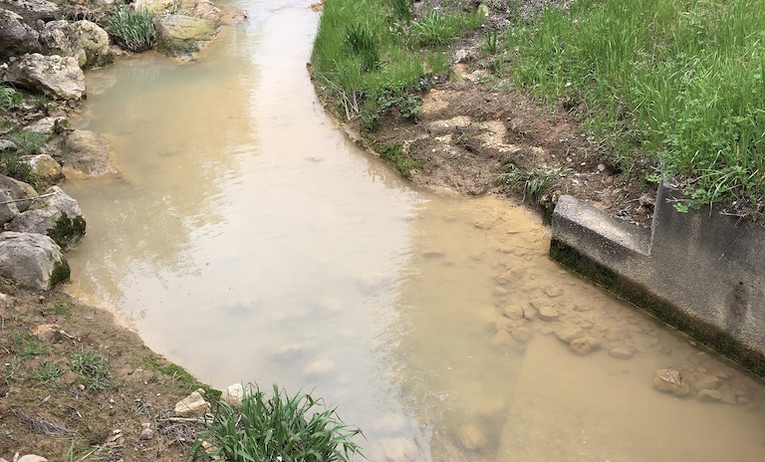
Reporting pollution and advocating for
Social and environmental justice
2019
Sulfuric acid discharged by Clover Flat Landfill

Slide 14
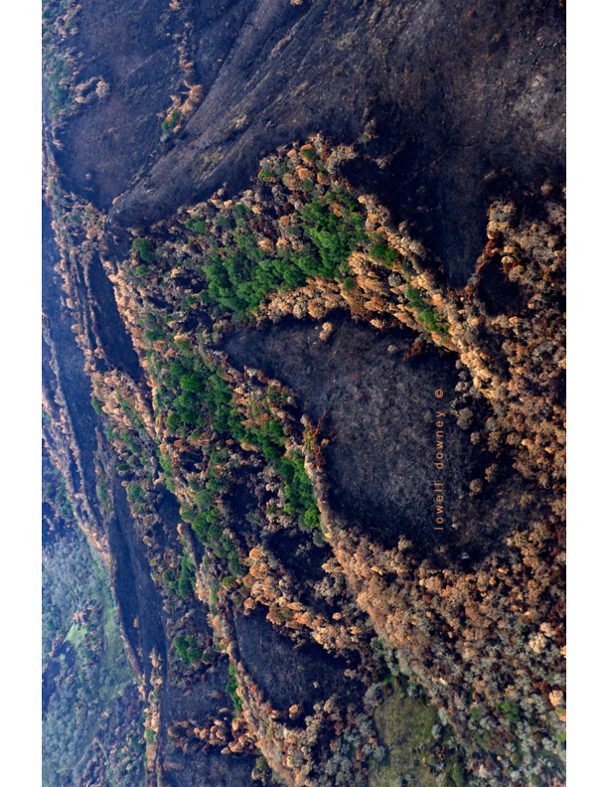
2017
ATLAS PEAK FIRE
DAMAGED WATERSHEDS FOR YEARS TO COME
LOSS OF GROUNDWATER PERCULATION AND INCREASED RUNOFF
CUMULATIVE IMPACTS TO WATERSHEDS FROM DEFORESTATION, FIRE,
GROUNDWATER
AND SURFACE WATER PUMPING

Slide 15
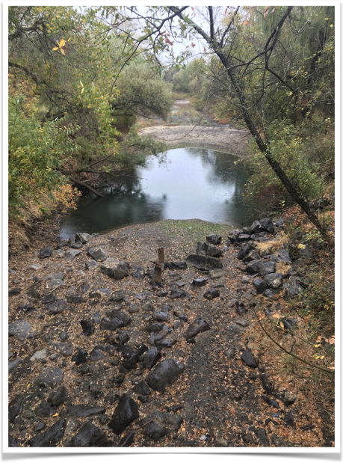
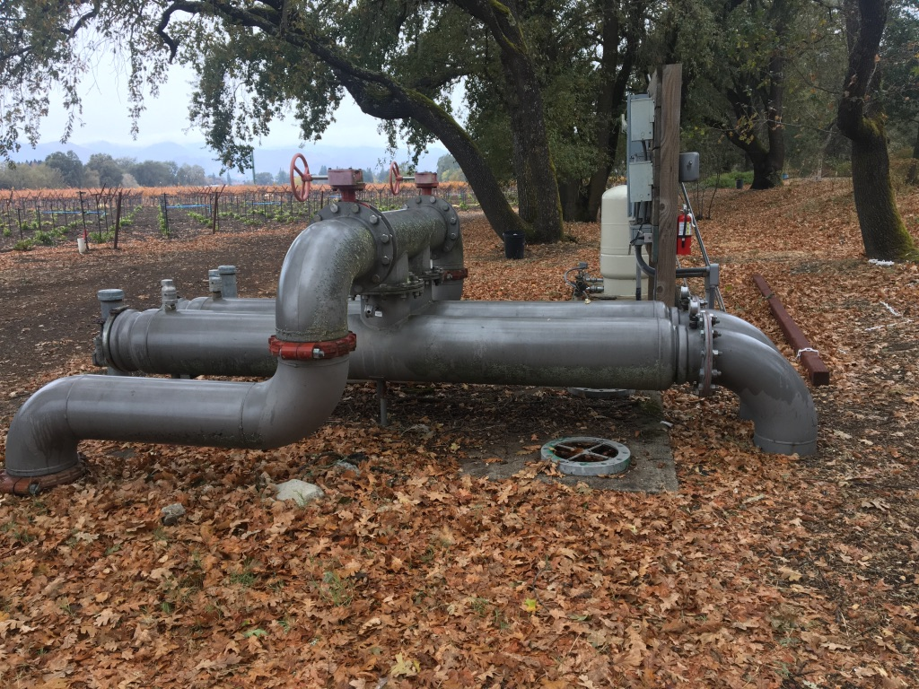
Napa River depleted due to water diversions and groundwater pumping

Slide 16
Hardening
Of the River
Bank Fails

Slide 17
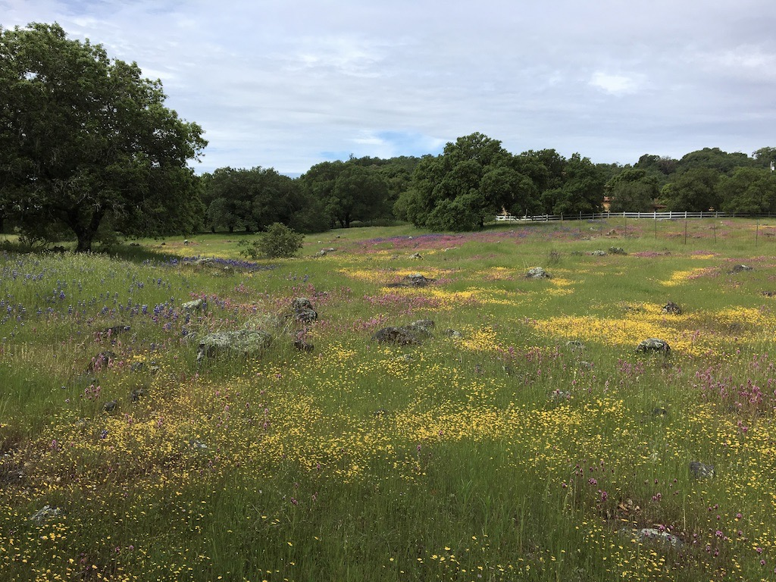
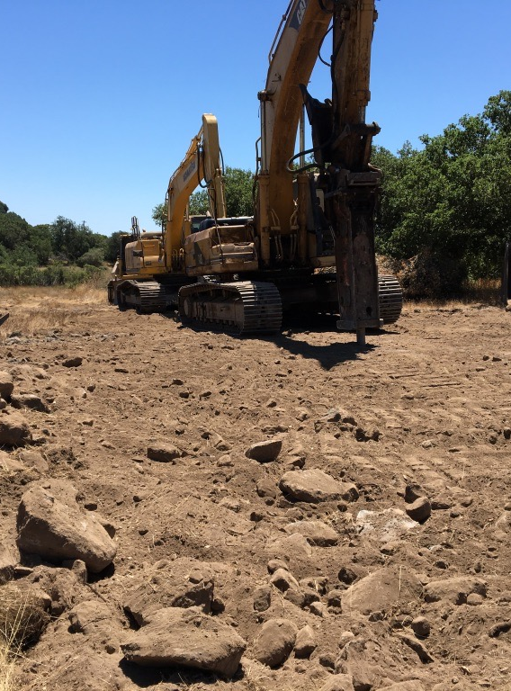
Vernal Pools
Atlas Peak
Failure to Protect
Vernal Pools
Precious

Slide 18
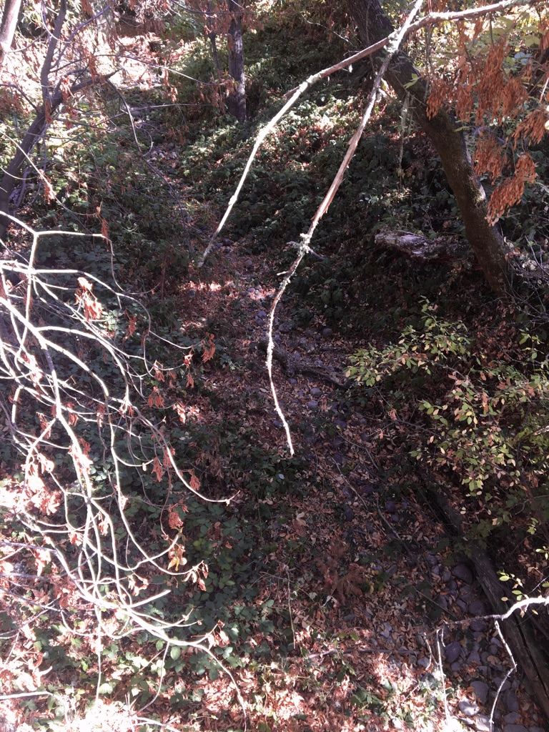
October 10, 2021
Headwaters of the Napa River below Kimball Dam
DRY
yet there are required by-pass flows from Kimball Dam.
Two years in a row the River is dry here and locals said this was the first time last year seeing the River dry here.

Slide 19
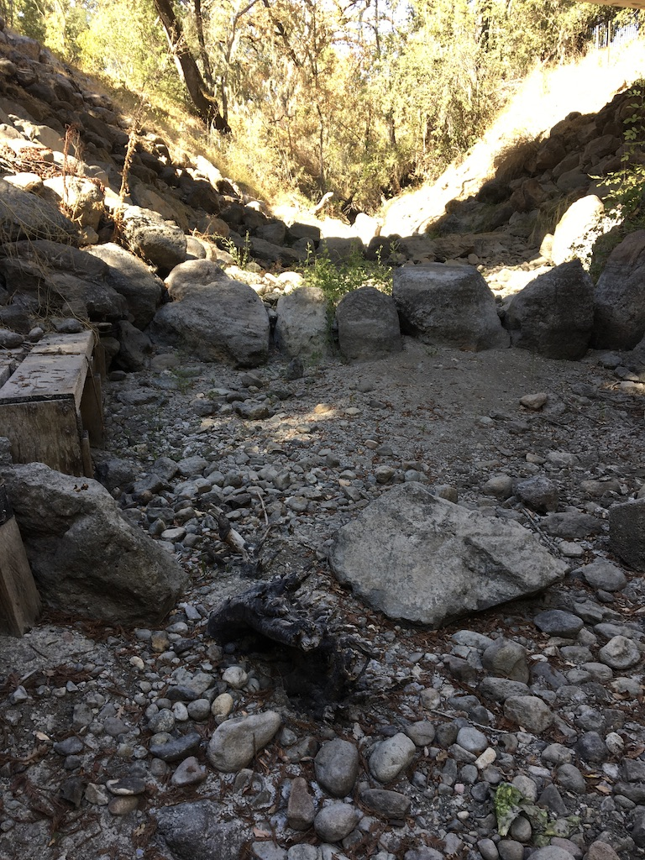
Coastal Conservancy Napa River restoration site for California Freshwater Shrimp
Greenwood Bridge Napa River dry two years in a row
October 10, 2021

Slide 20
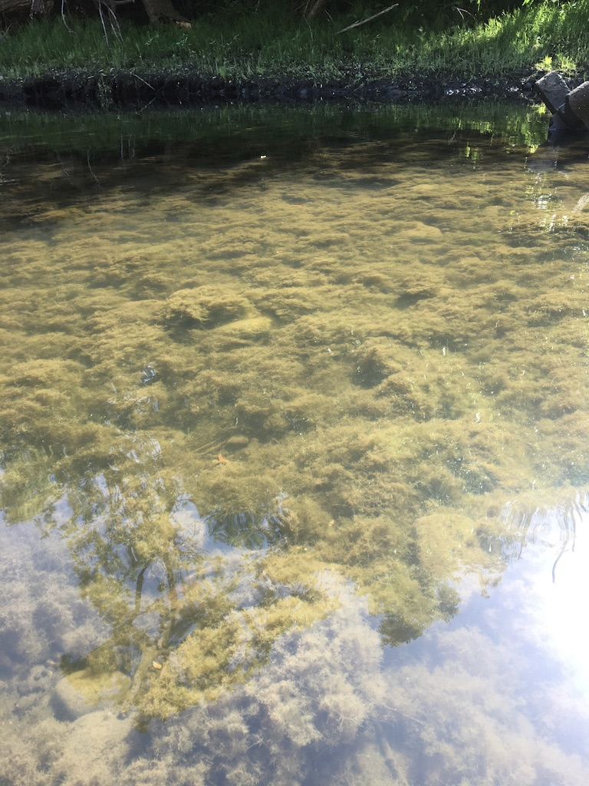
Napa River May 2021 stagnant pools;
As flows decline, water quality plummets
Harmful &toxic freshwater algae blooms occur
ICARE assists with tests and monitoring

Slide 21
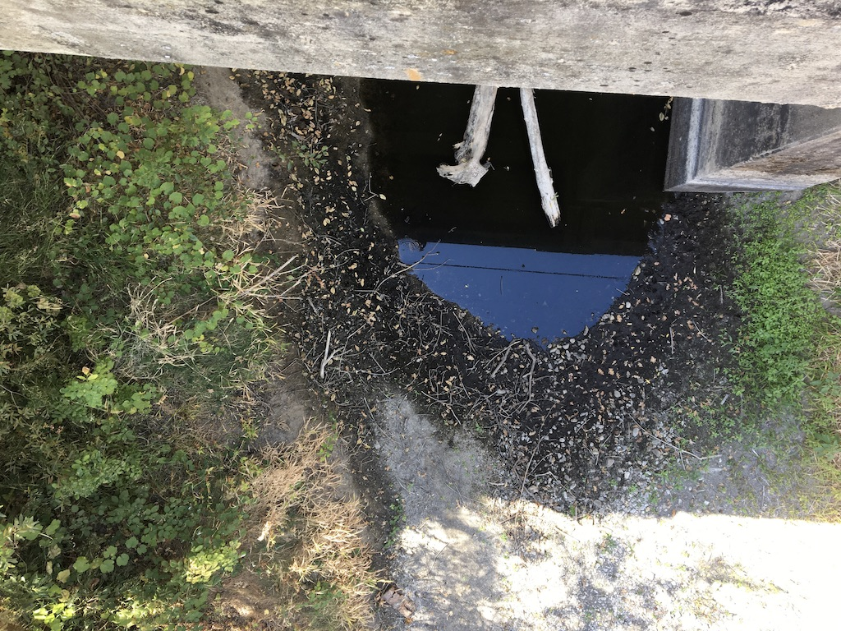
The Napa River is a groundwater dependent ecosystem. Larkmead Bridge & where the River is surrounded by
groundwater pumping. Notice the fast drying of this pool
which is depicting groundwater levels dropping.

Slide 22
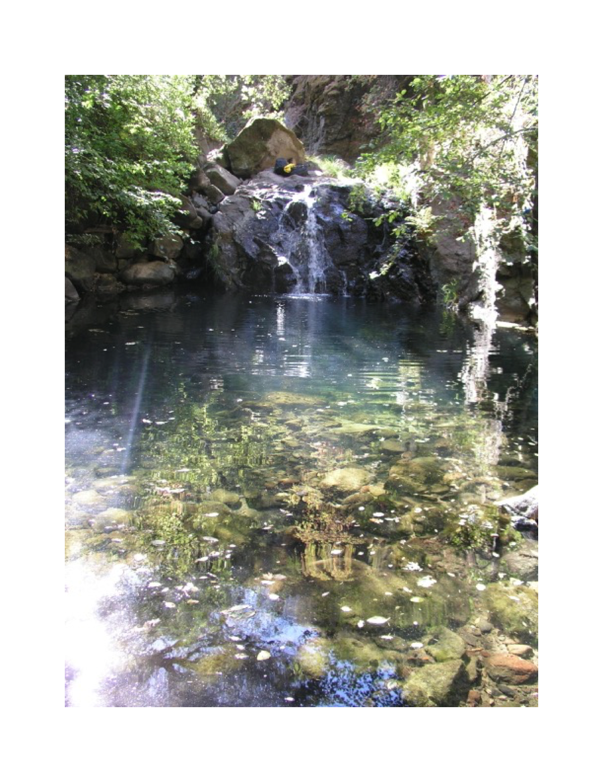
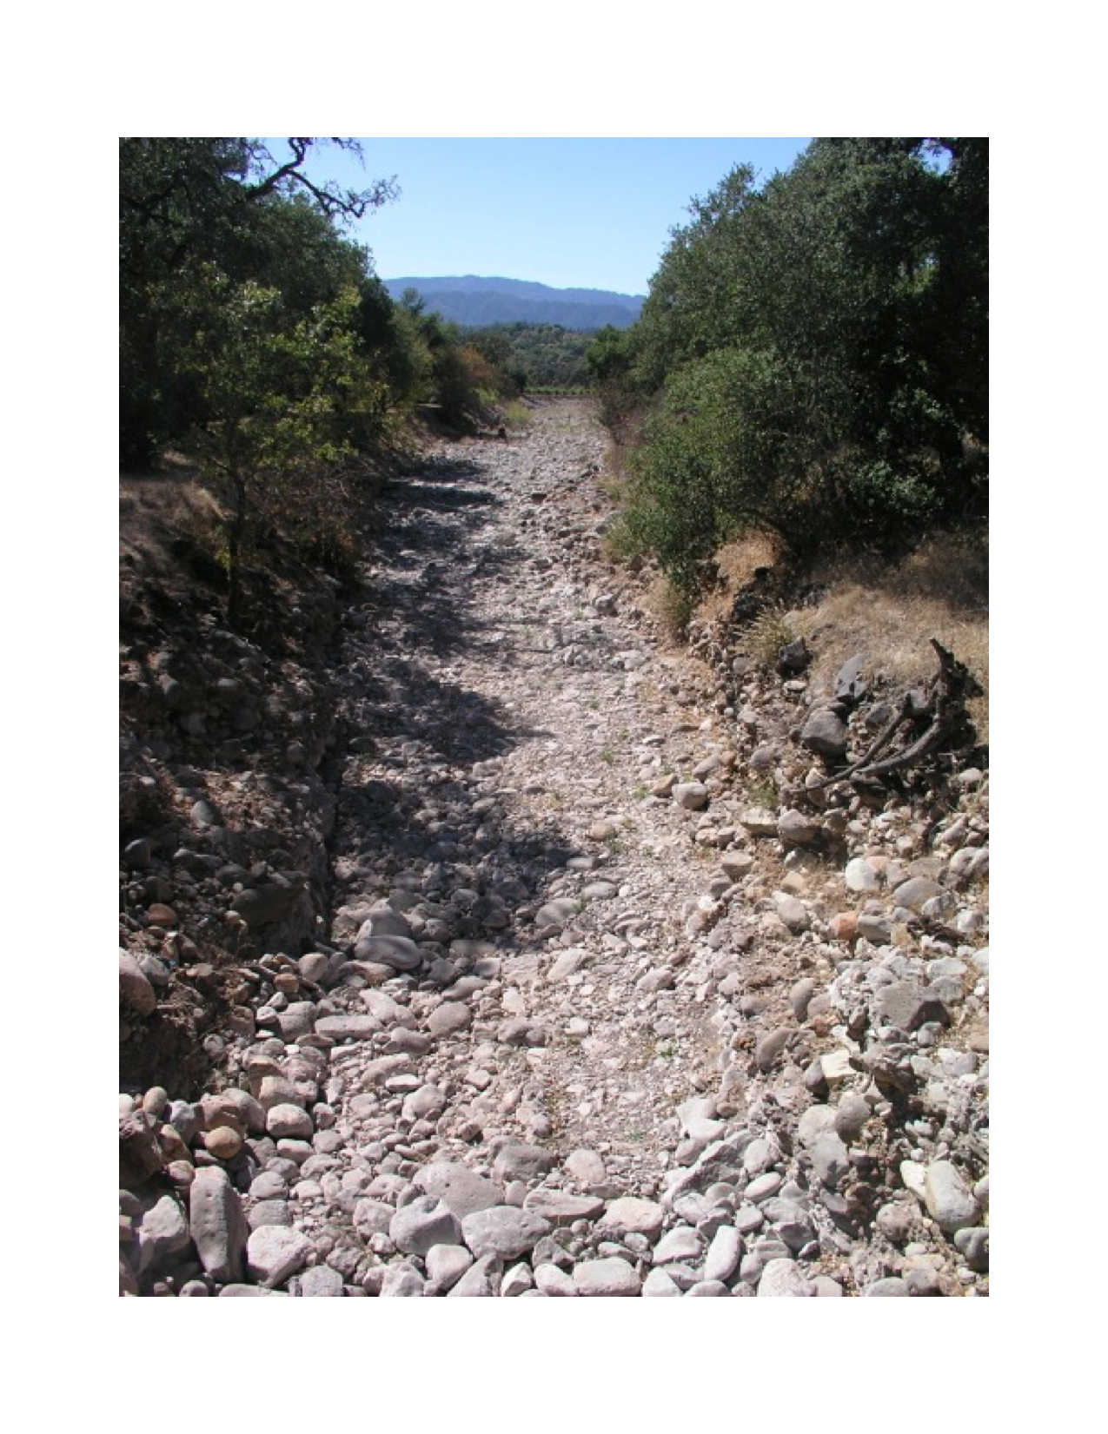
RECTOR CREEK BELOW THE DAM
Rector Creek above the reservoir diversion

Slide 23
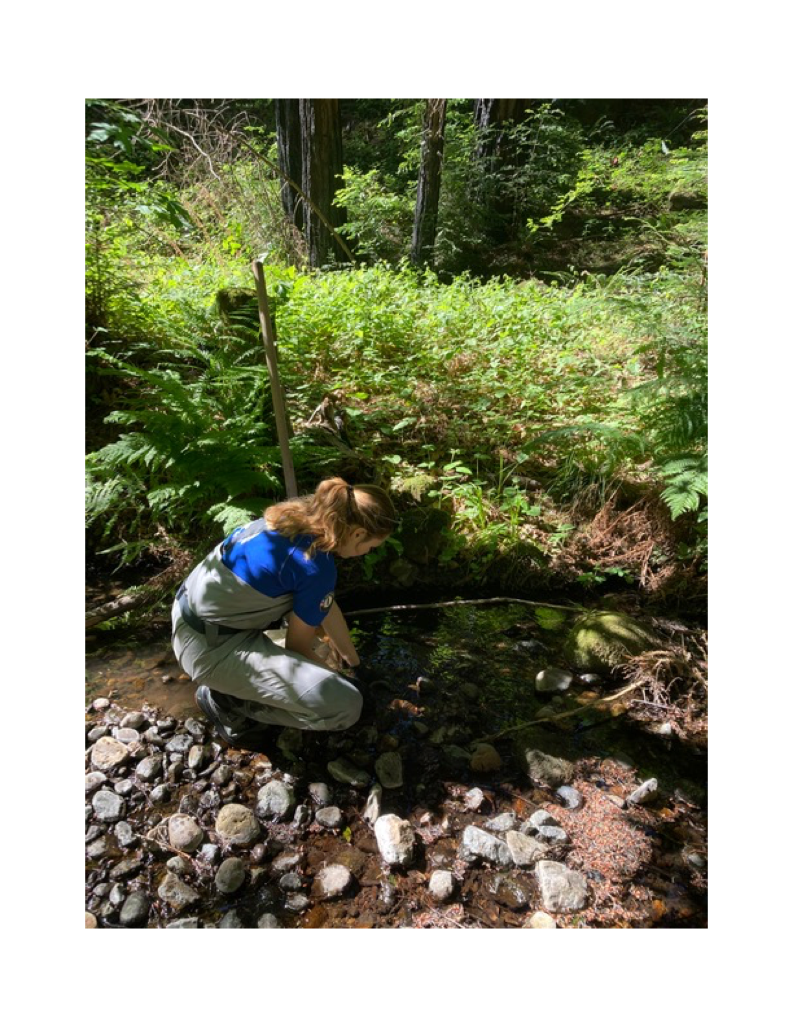
Collecting Aquatic Insects Since
2000

Slide 24
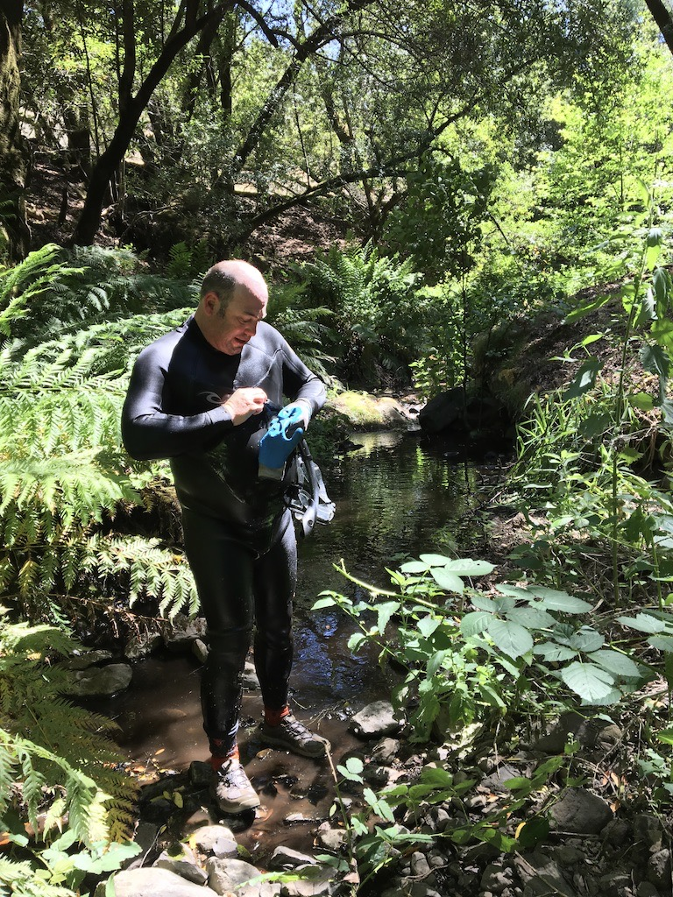
Snorkel Survey to Monitor
The Health of Fish
Since 2000

Slide 25
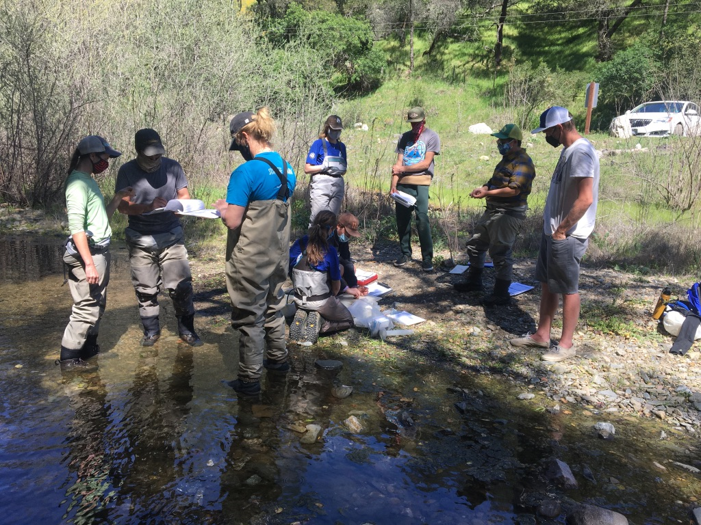
The Institute for Conservation Advocacy
Research and Education
Studies the Napa River since 2004
In May 2021 we began a bio-assessment project
collecting water, algae and aquatic insects in 28
streams

Slide 26
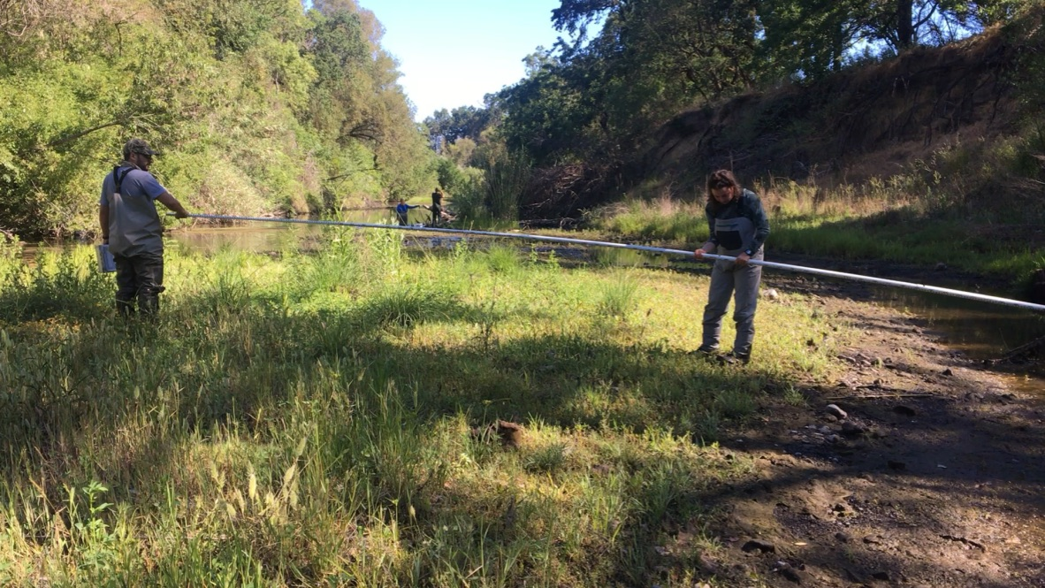
Napa River just above the tide
May 21 2021
Very little flowing water
Measuring bank full

Slide 27
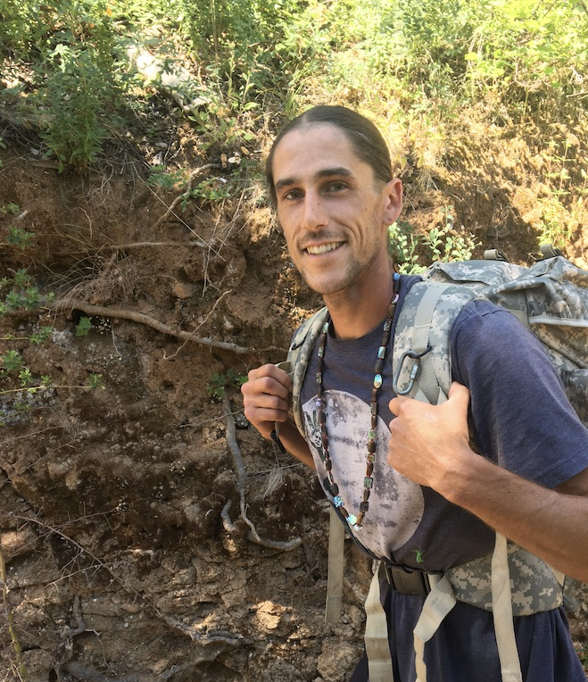
ICARE’S BOARD MEMBER: Alyx Howell and
Direct Wappo decendent, one of 300 tribal
people alive today who provides, skills like guide and advisor about local Native culture.

Slide 28
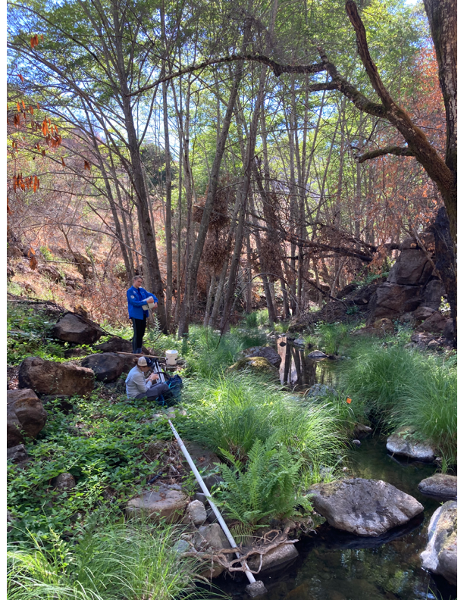
Bell Canyon Creek above the reservoir in
the deep canyon with flows and no
diversions
(some fire impacts)
preparing to survey gradient of the stream

Slide 29
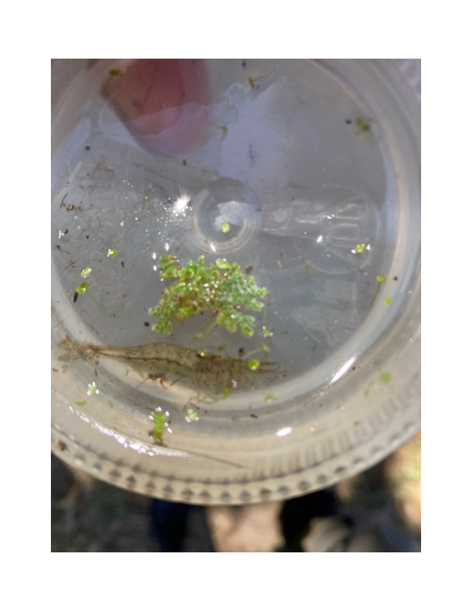
Huichica Creek
California Fresh Water Shrimp
May18, 2021

Slide 30
The Napa River, The Lost River
THE PUBLIC CAN NOT FISH, SWIM OR RECREATE
Deforestation, over extraction of surface and groundwater for vineyards is depriving the River
Of water recharge.
Napa County continues to allow new groundwater wells for wineries
and vineyards, which are the main extractors of water
drying our streams and River.
Excessive extraction of water is killing all aquatic life
including threaten and endanger species like
Chinook salmon
steelhead
California Fresh Water Shrimp
Western Pond Turtles.
Municipal reservoirs are at high risk of not being able to
provide potable water due to lack of fresh water flows
causing increased higher concentration of contaminants like nitrates
enriching harmful and toxic algae blooms.
Wells all over the County are going dry.
CLIMATE CHANGE EXACERBATES ALL OF THIS!
A MORATORIUM ON DEVELOPMENT IS NEEDED

Slide 31
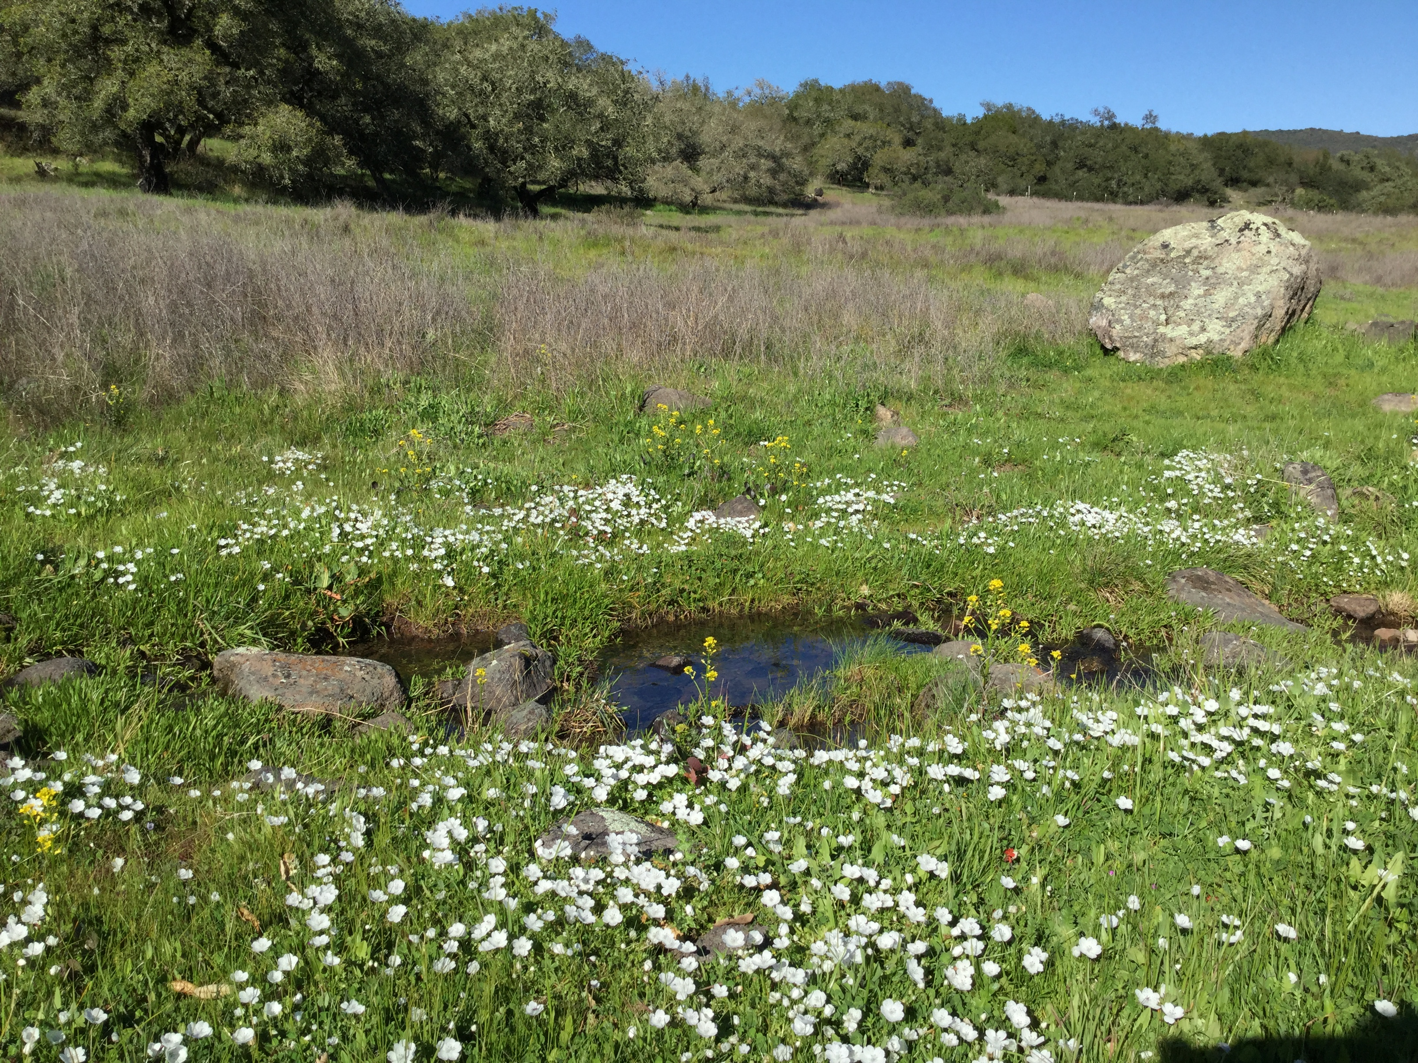
Groundwater is interconnected to streams.Depleting groundwater depletes surface waters like streams, seeps, wetlands and lakes

Slide 32
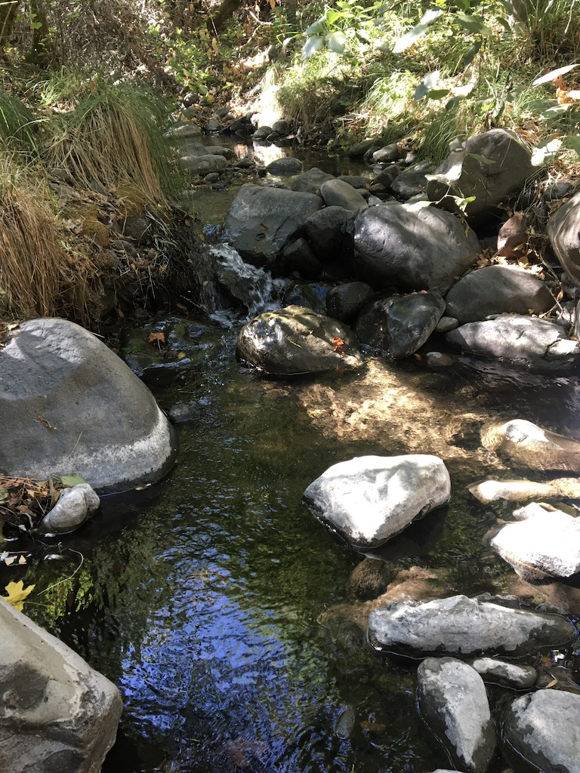
Mill Creek October 10, 2021 severe drought
conditions and there are flows in Mill Creek State Park
WHY? No water diversions.

Slide 33
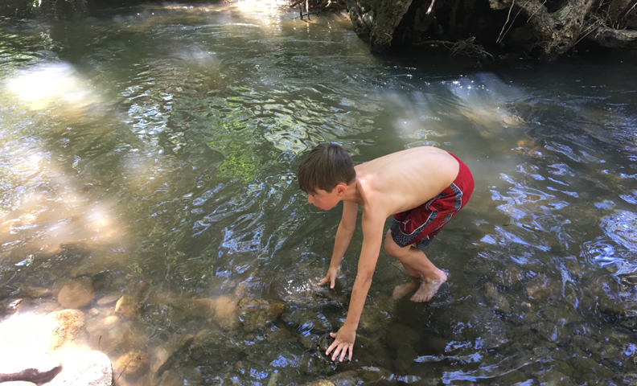
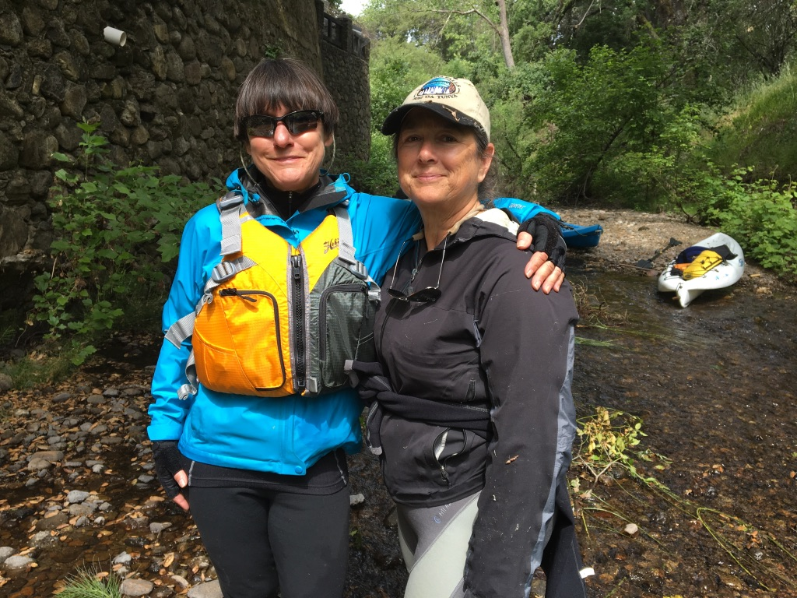
The Public Trust Doctrine, since Justinian times protects in perpetuity, the
human right to fish swim and recreate.

Slide 34
What does a lost River mean?
No more water
No access to the River
Diminished surface and groundwater
No water for wildlife, plants and fish
No swimming, fishing and recreation
WITH CLIMATE CHANGING A LOST RIVER MEANS NO
CLEAN FLOWING WATER FOR EVERY LIVING THING
A TERRIBLE LOSS OF PUBLIC TRUST RESOURCES

Slide 35
WHAT CAN YOU DO TO REDUCE
CLIMATE CHANGE
GO ELECTRIC
PROTECT NATURAL LANDSCAPES
REDUCE, REUSE, REPURPOSE, RECYCLE
PURCHASE LOCAL FOOD
VEGETARIANISM
ELIMINATE PLASTIC-A PETROLEUM PRODUCT; MICRO-PLASTIC POLLUTION
GET POLITICALLY INVOLVED
COMPOSTING

Slide 36
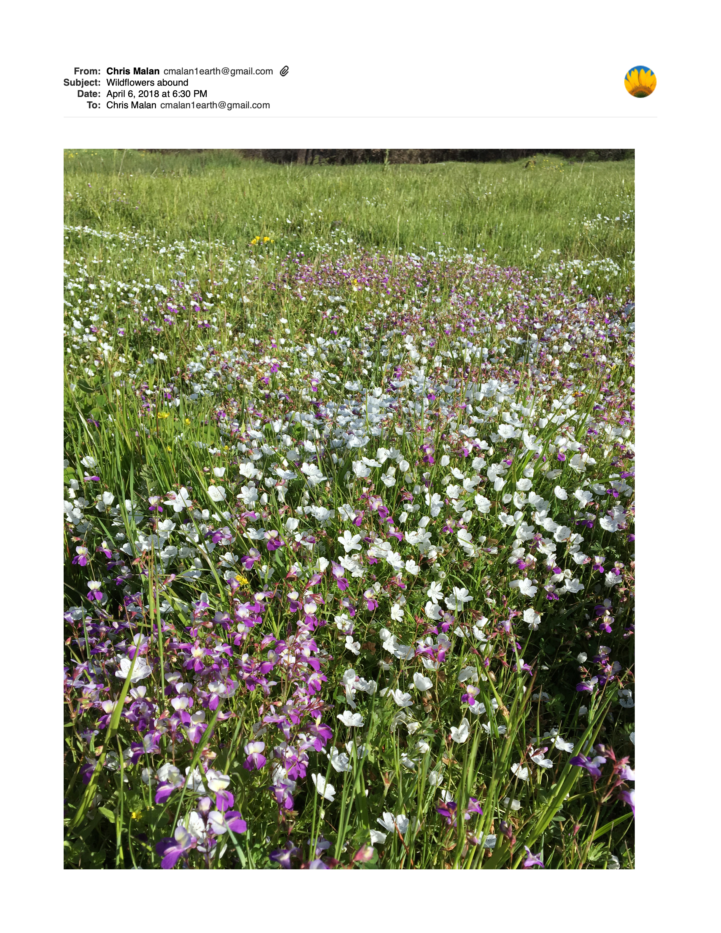
HEAR ME WHILE YOU CAN
NATURE IS CRITICAL TO OUR SURVIVAL
IT’S VOICE MUST BE HEARD
HELP THE CREATOR OF ALL THINGS
LISTEN TO THE SOUNDS OF NATURE
HELP PROTECT IT FOR FUTURE GENERATIONS

